Slide 1
Numerical Analysis (6/7) Linear systems
University of Luxembourg - 2024
Master in Mathematics
Hadrien Beriot

Slide 2
Outline
1. Introduction
2. Direct Methods
3. Iterative methods
4. Summary

Slide 3

1. Introduction

Slide 4
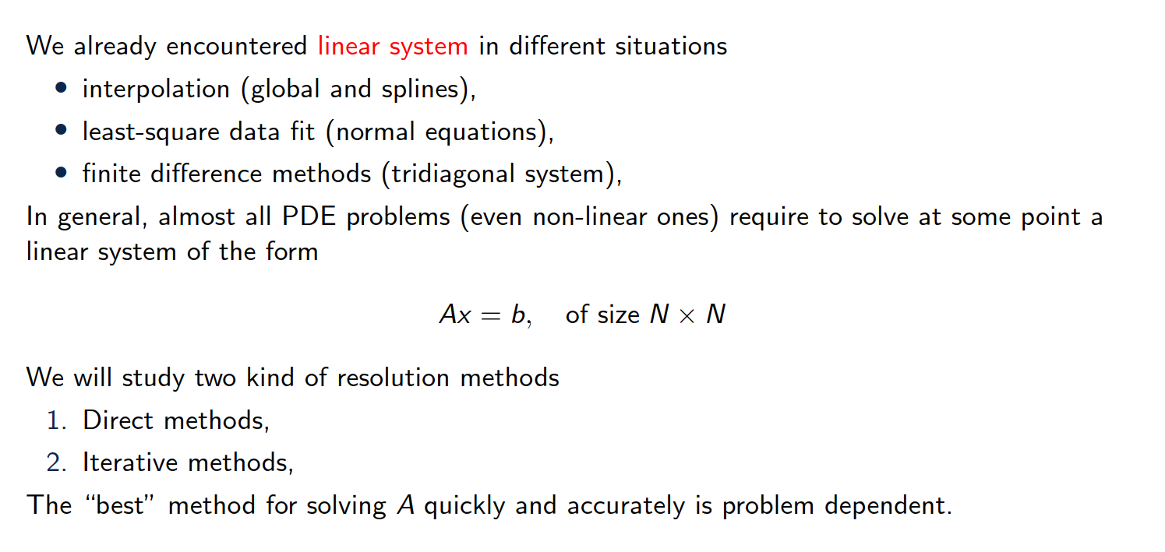
Overview of the content
Notes:
The image represents a Lorenz attractor, which is a three-dimensional chaotic attractor discovered by the mathematician Edward Lorenz.
The Lorenz attractor is a graphical representation of the solutions to a set of differential equations that describe a simplified model of atmospheric convection, known as the "Butterfly effect".
The image shows the characteristic butterfly-like shape of the Lorenz attractor, which demonstrates the sensitive dependence on initial conditions that is a hallmark of chaotic systems.

Slide 5
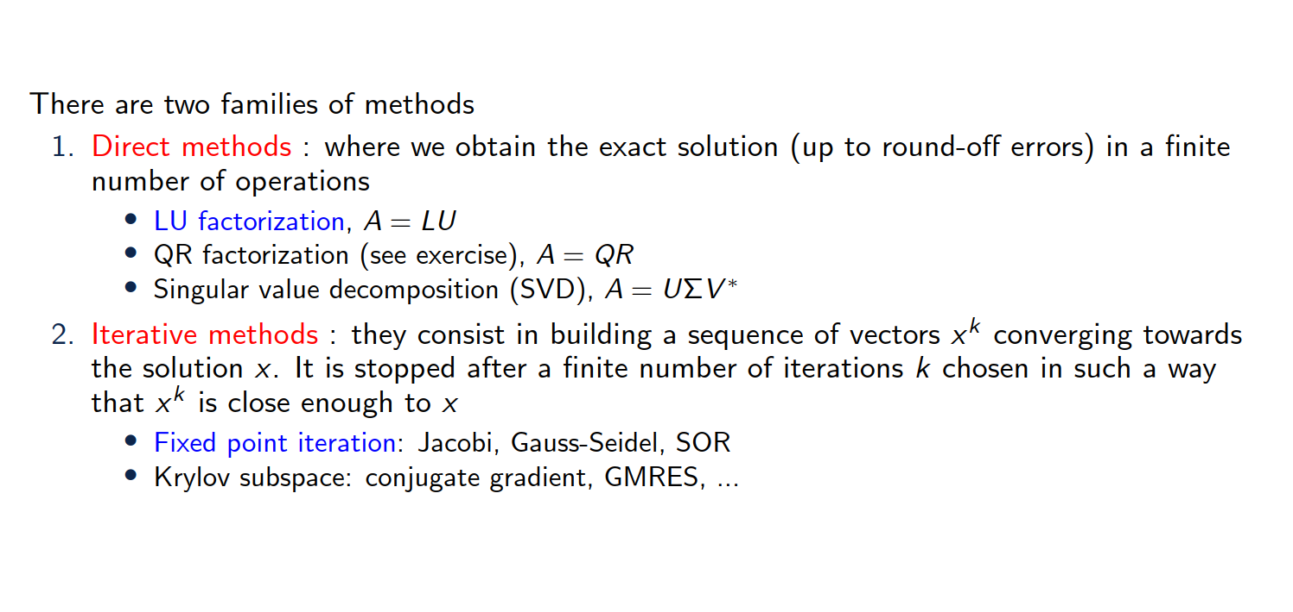
Overview of the content

Slide 6
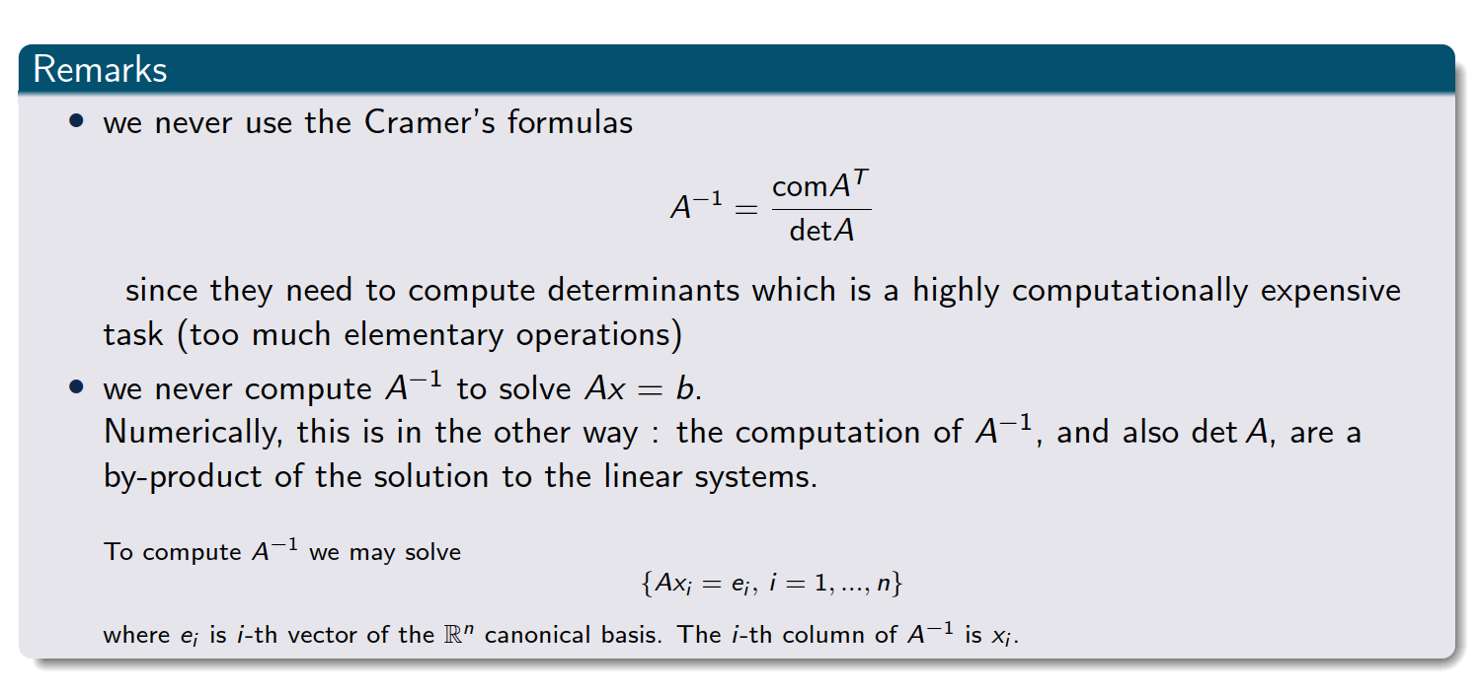
Important remarks
Notes:
The comatrix of a matrix AAA is the transpose of the matrix of cofactors of AAA.Each cofactor is obtained by calculating the determinant of the submatrix that remains after removing the row and column corresponding to the element in question, with an appropriate sign adjustment based on the position.

Slide 7
2. Direct methods

Slide 8
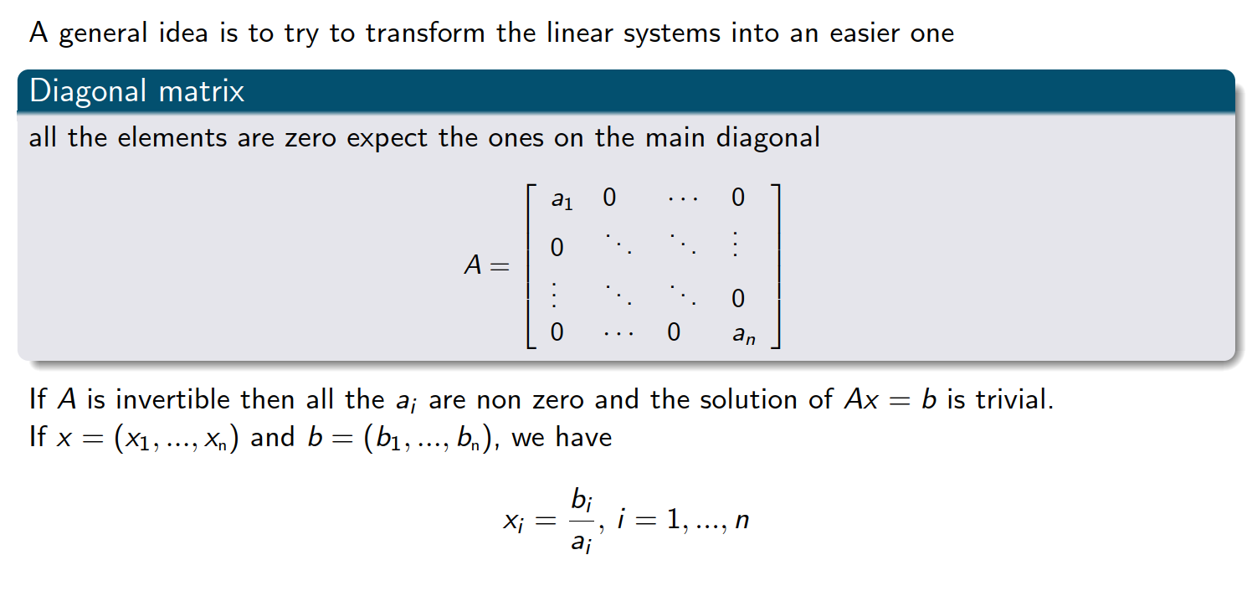
Linear system that is easy to solve

Slide 9
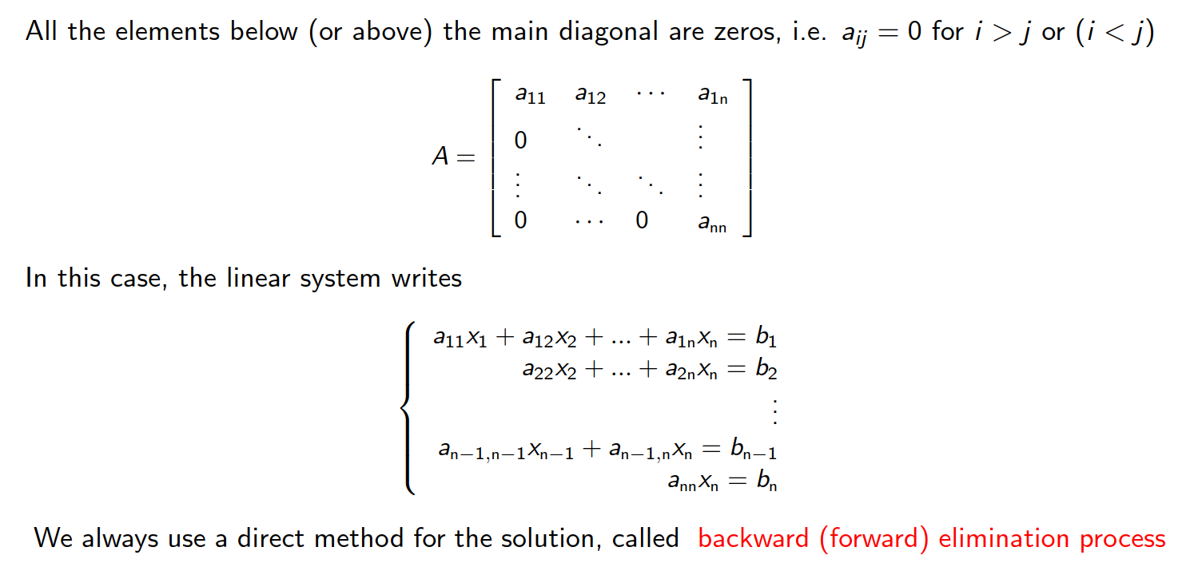
Upper (or lower) triangular matrices

Slide 10
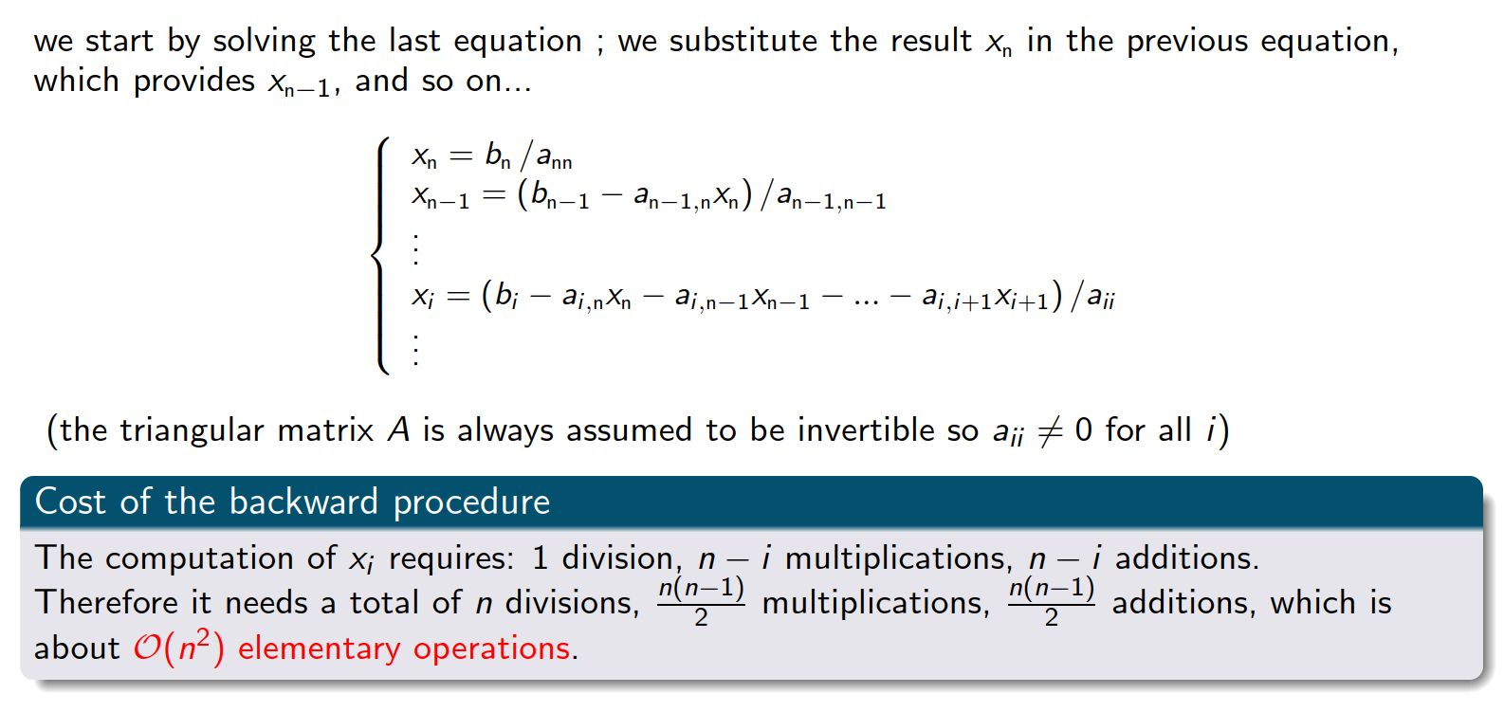
Backward substitution

Slide 11
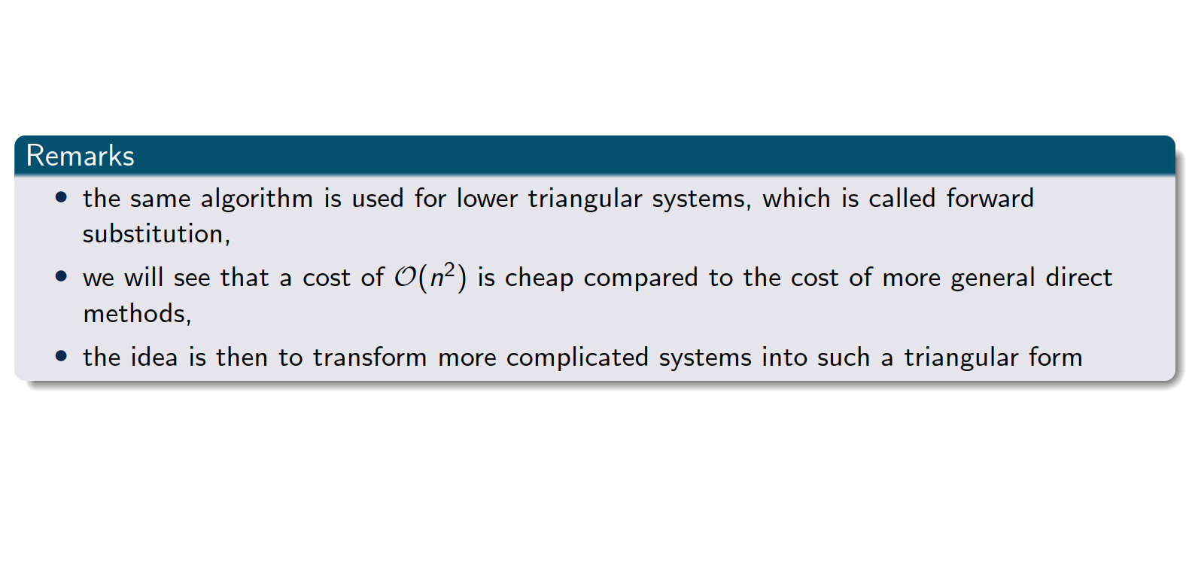
Upper (or lower) triangular matrices

Slide 12
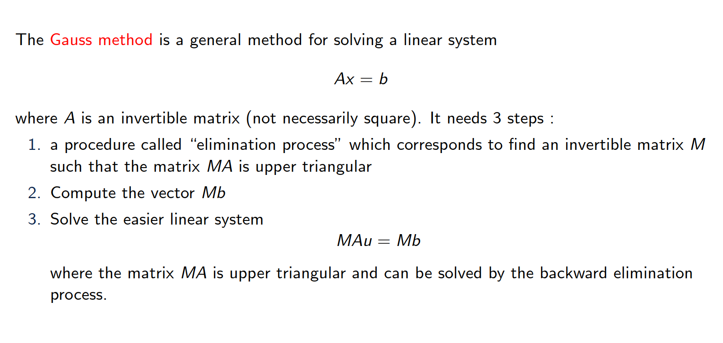
Gauss elimination

Slide 13
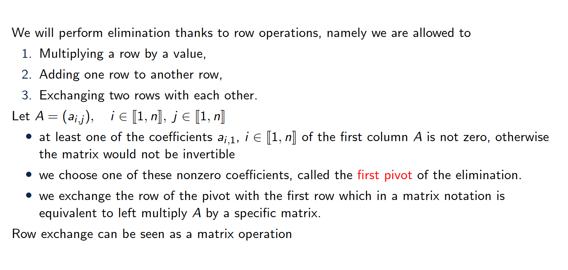
Description of the first step

Slide 14
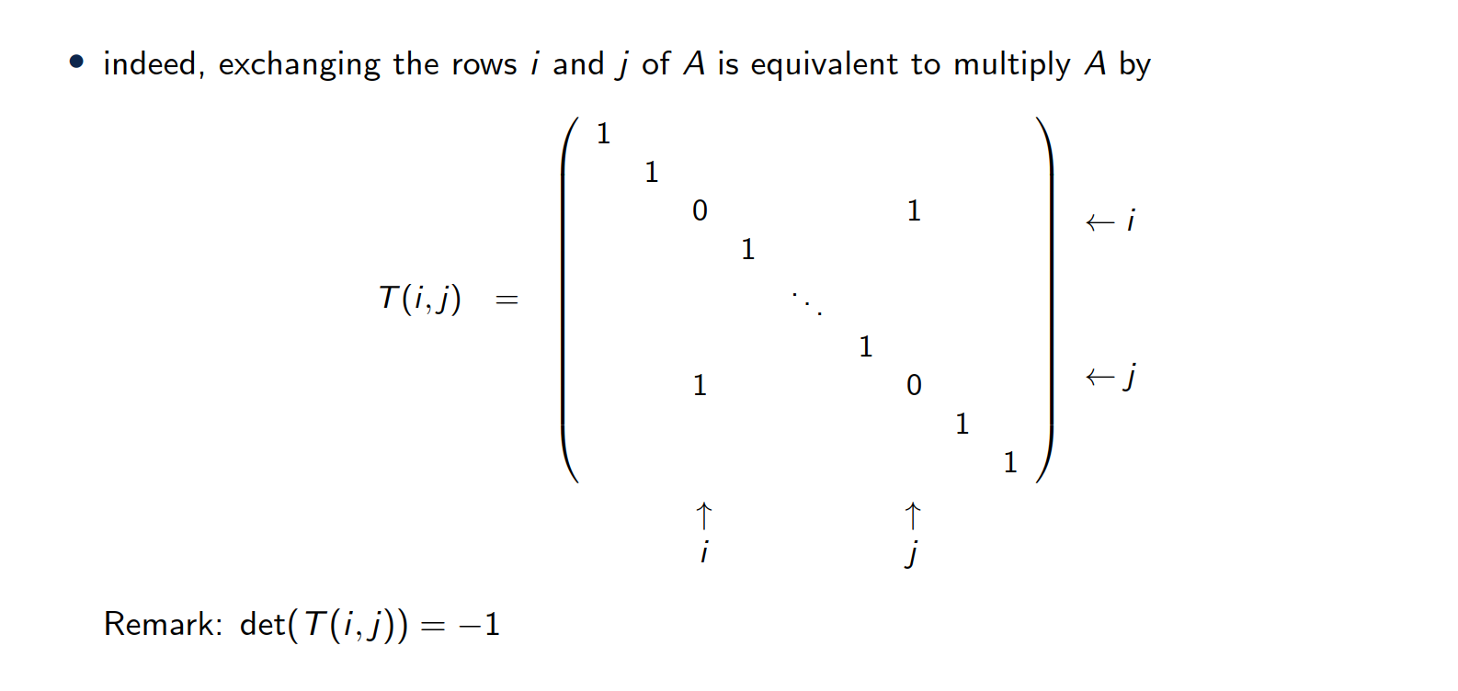
Description of the first step - Row exchange

Slide 15
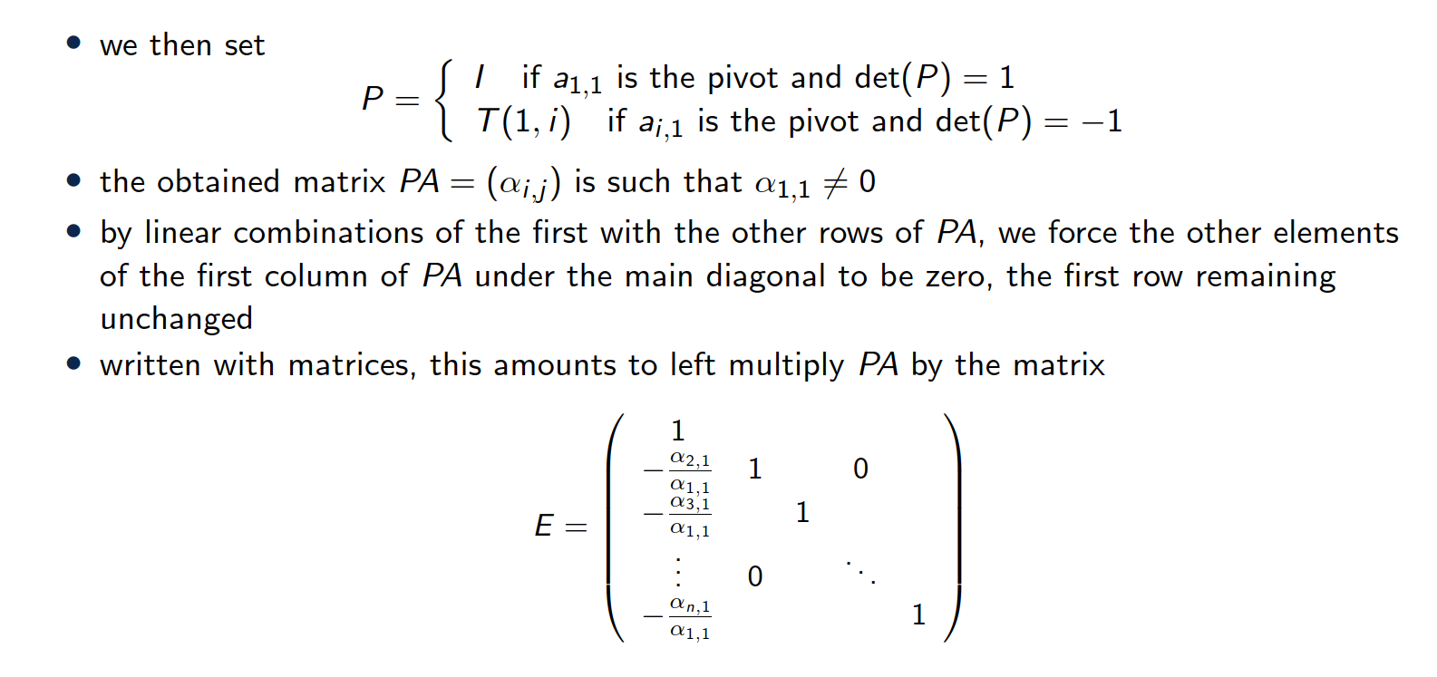
Description of the first step - scaling and adding rows

Slide 16
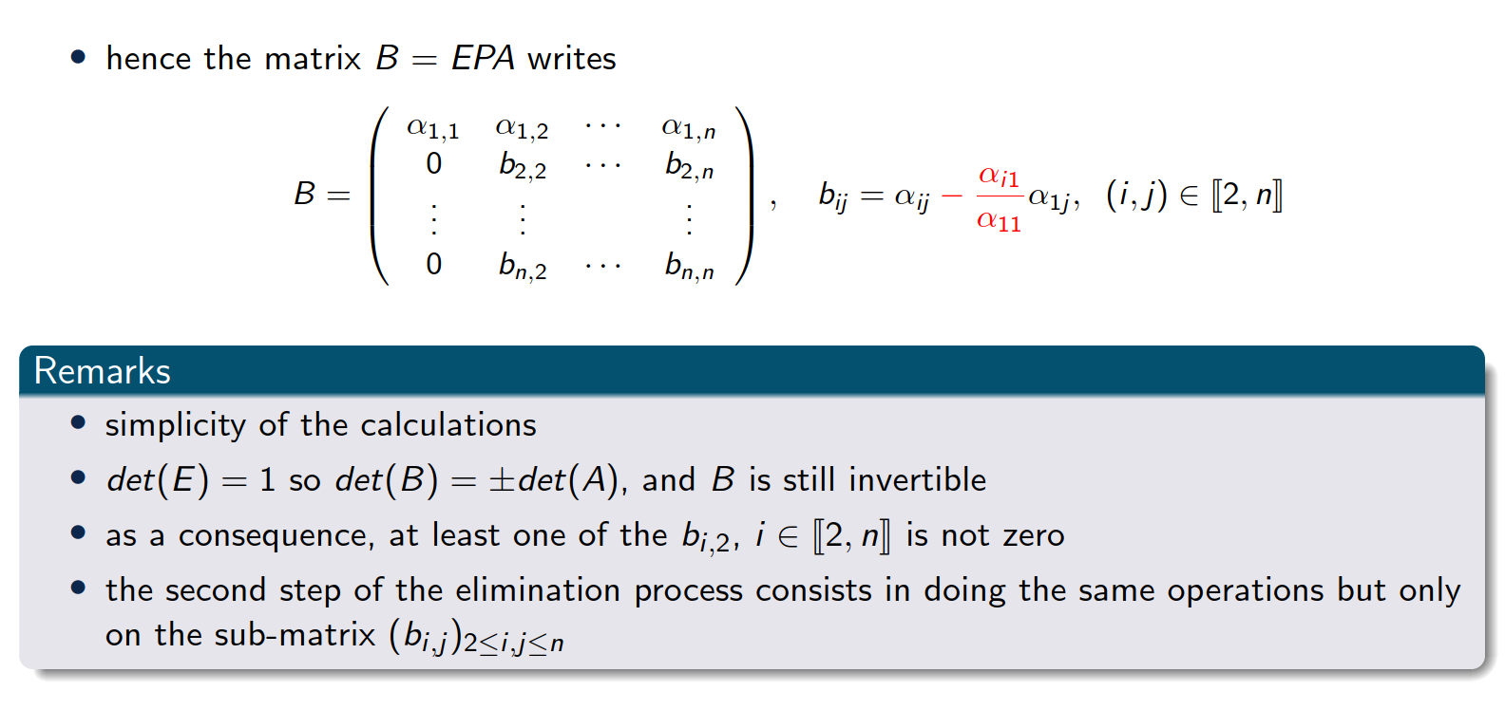
Description of the 1st step

Slide 17
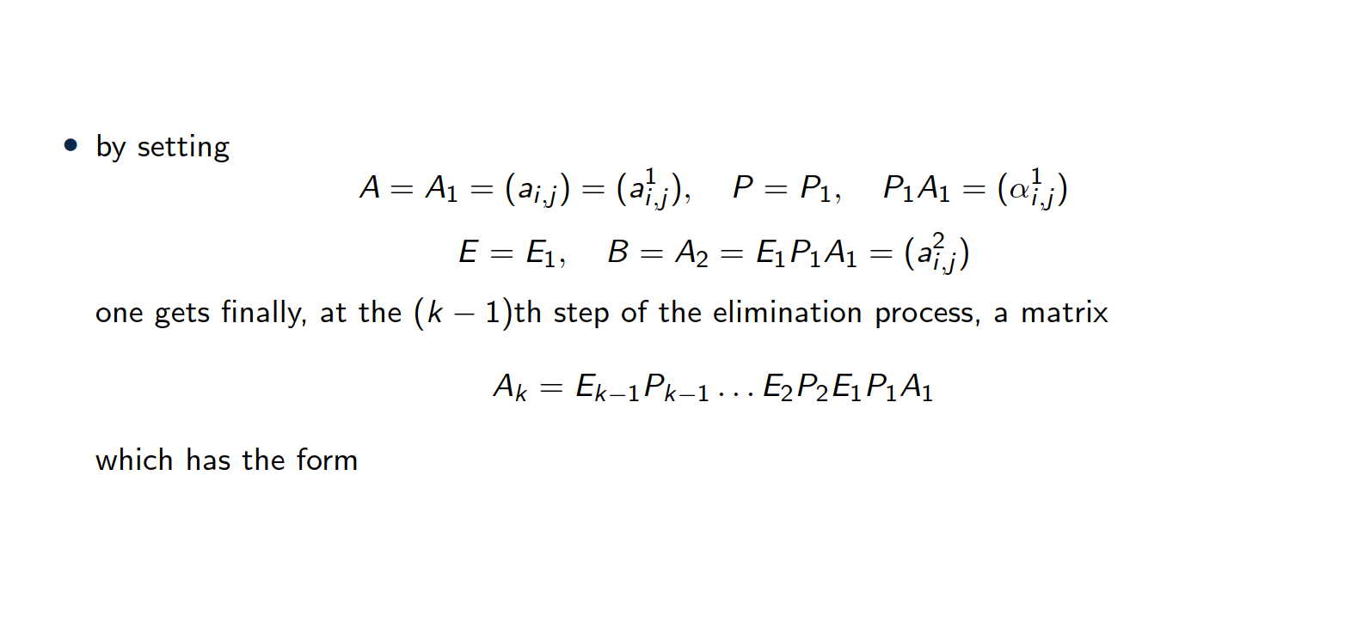
Description of the kth step

Slide 18
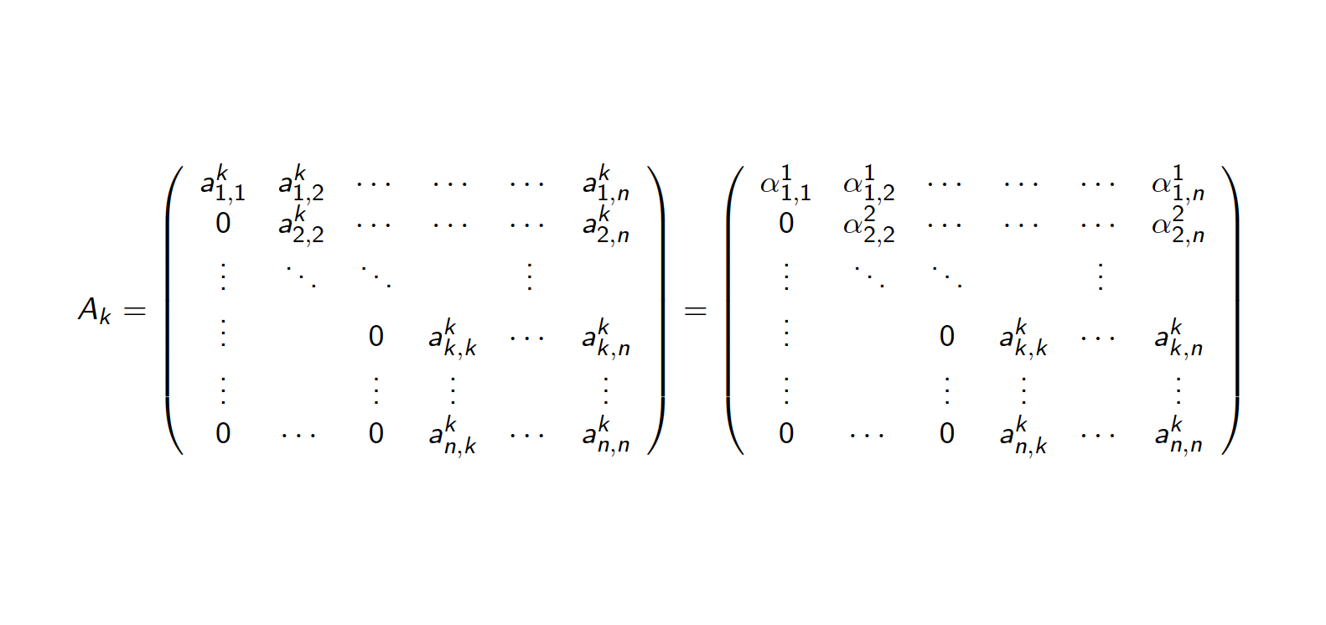
Description of the kth step

Slide 19
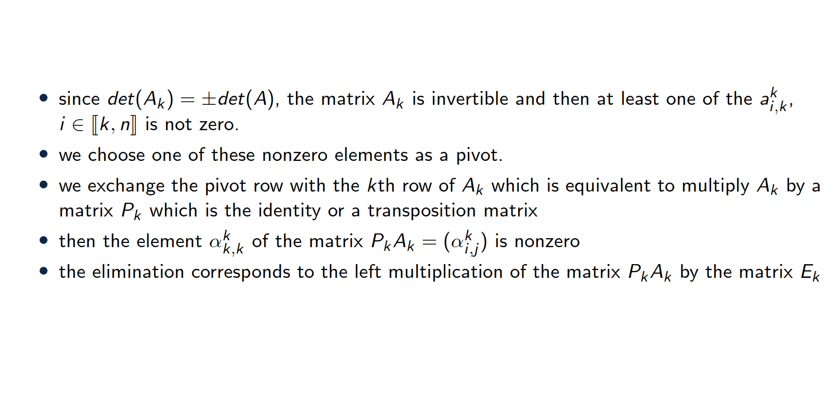
Description of the kth step

Slide 20
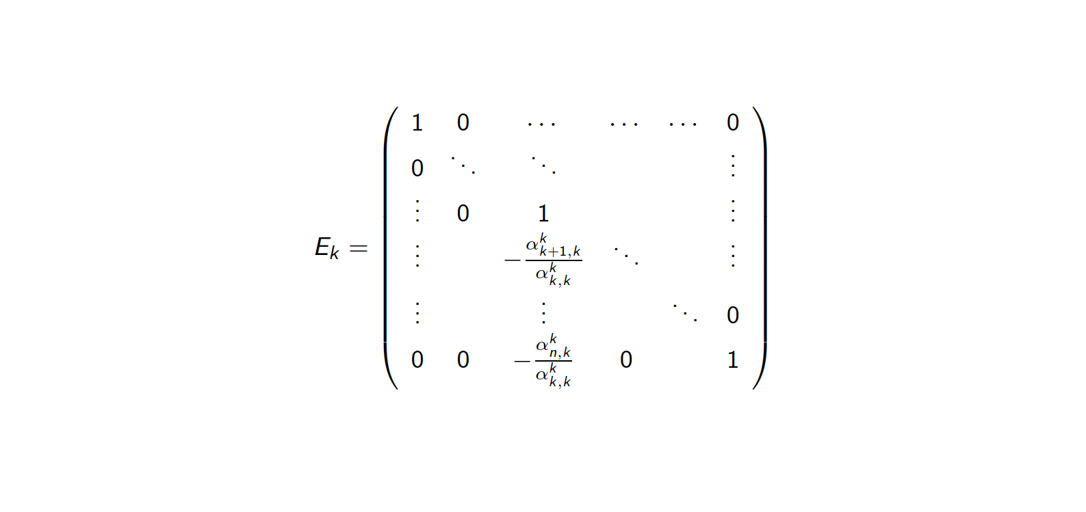
Elimination matrix at kth step

Slide 21
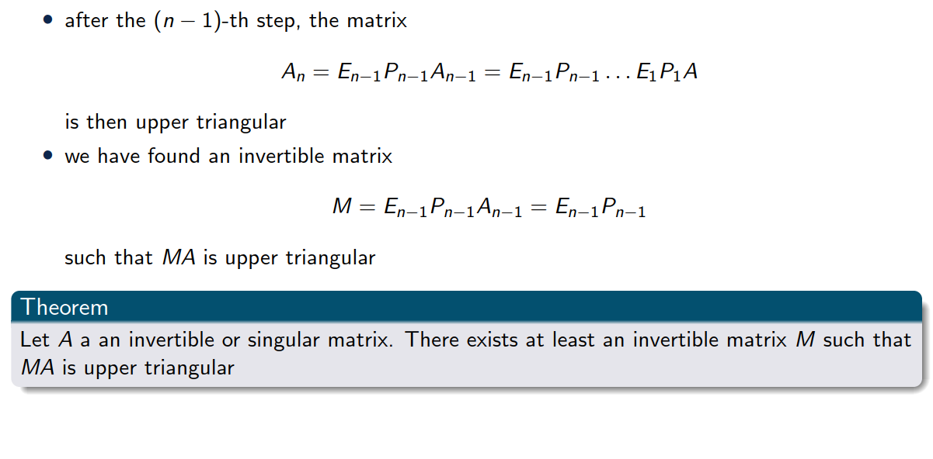
In the end…

Slide 22
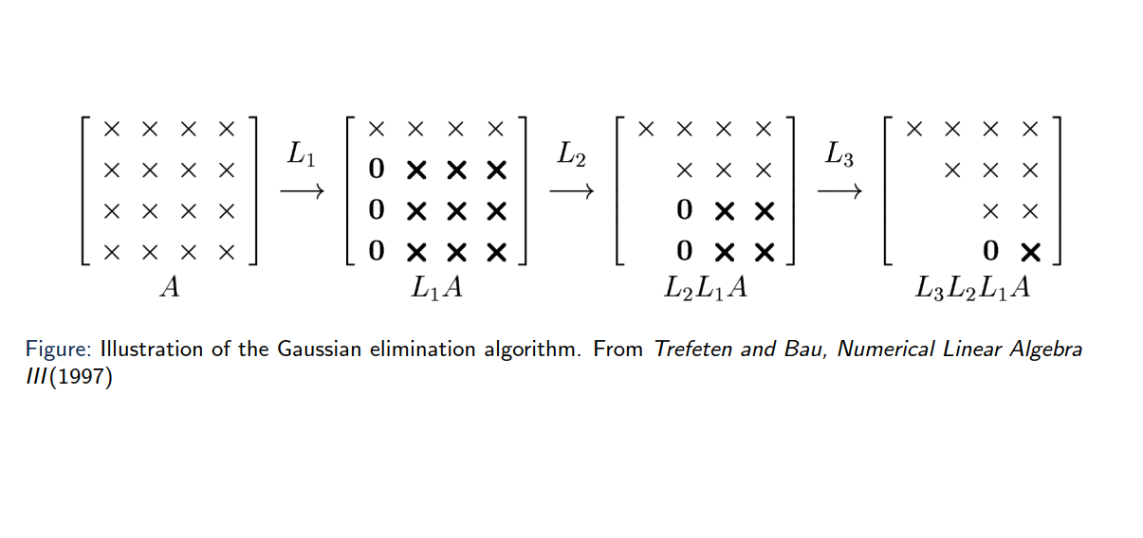
Illustration of the algorithm

Slide 23
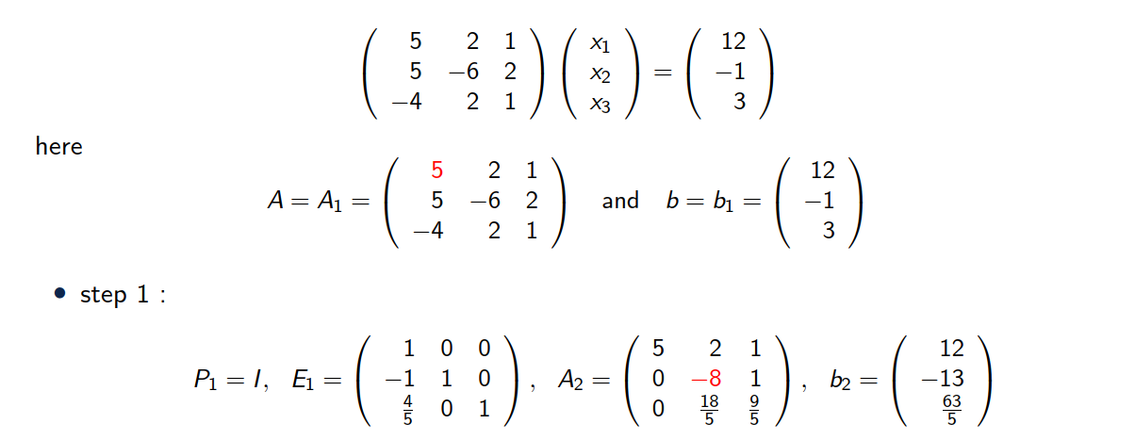
Example 3x3 linear system

Slide 24
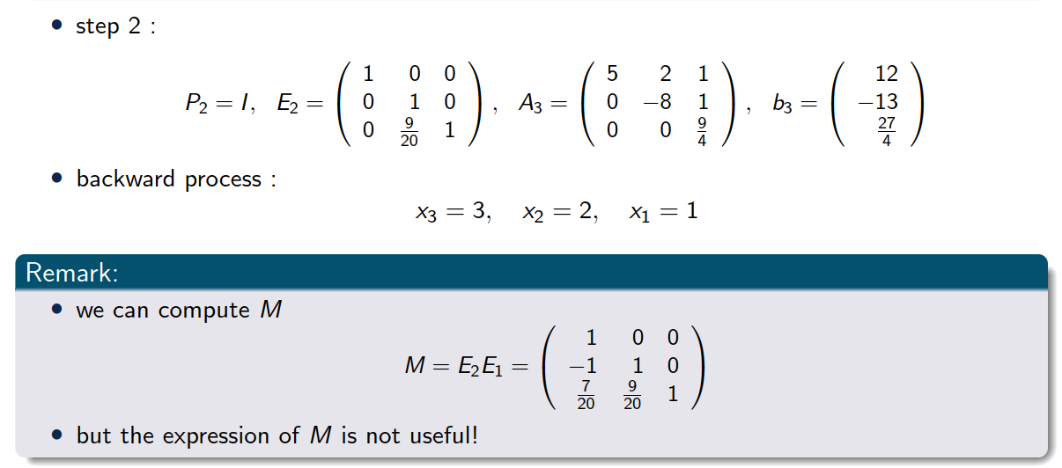
Example 3x3 linear system

Slide 25
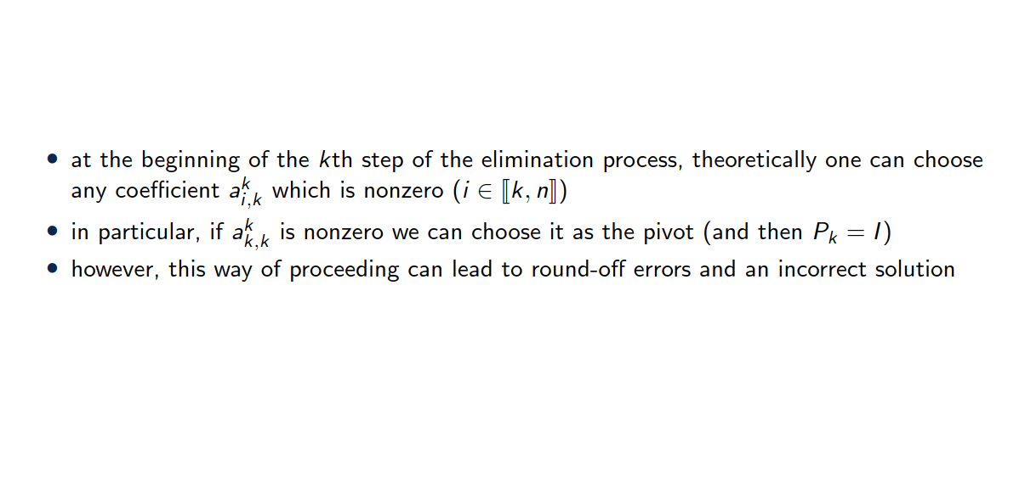
Choice of the pivot

Slide 26
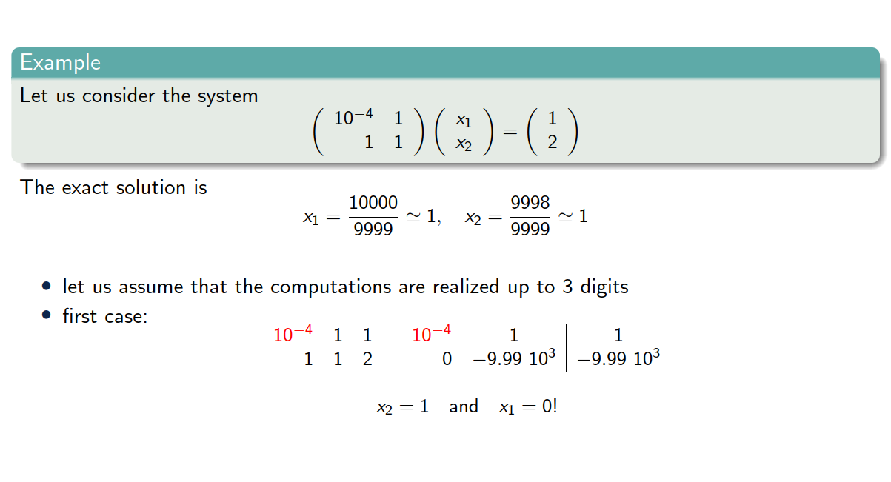
Choice of the pivot

Slide 27
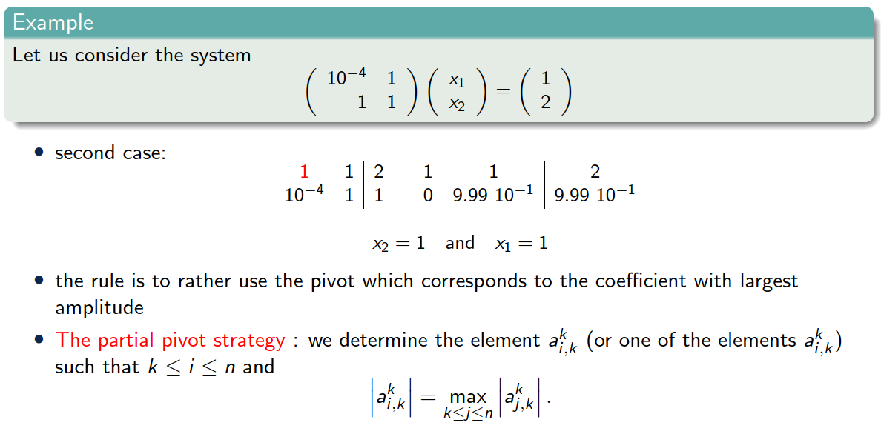
Choice of the pivot

Slide 28
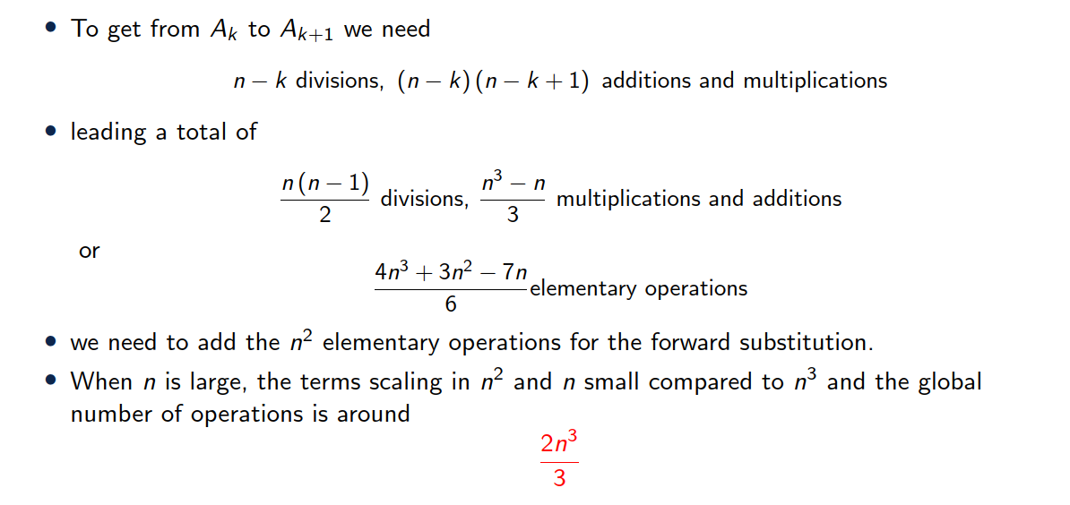
Cost of Gauss method

Slide 29
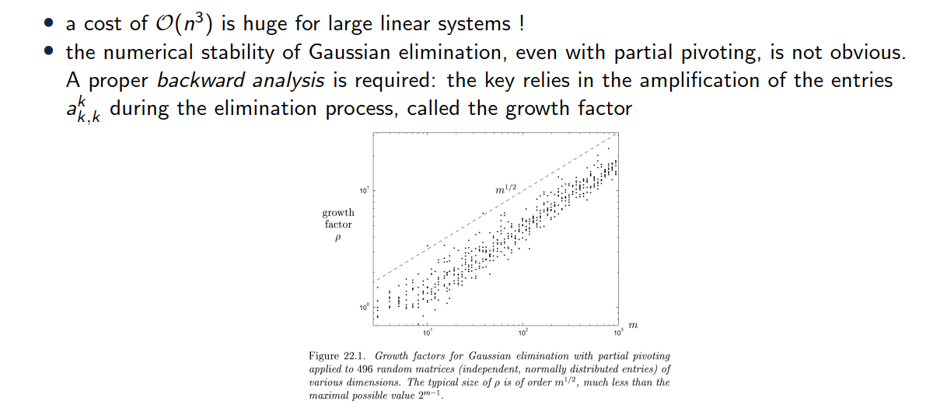
Remarks

Slide 30
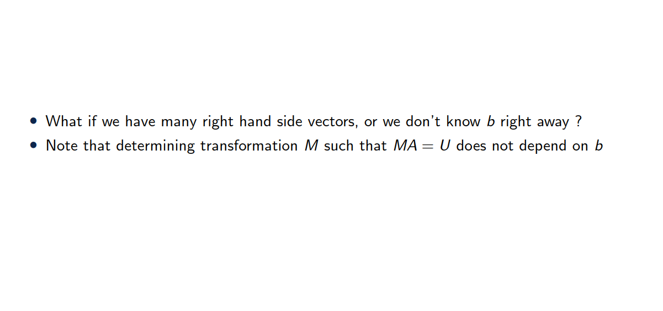
Remarks

Slide 31
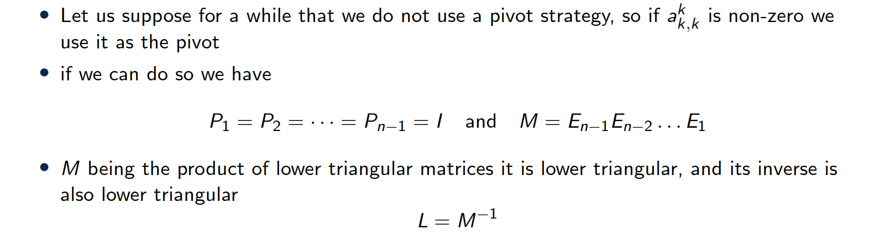
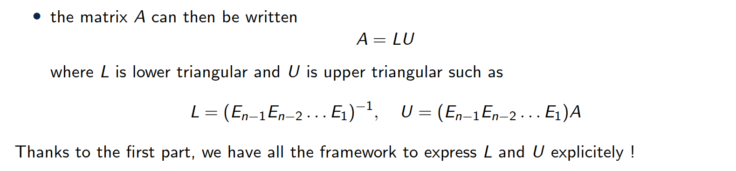
LU factorization

Slide 32
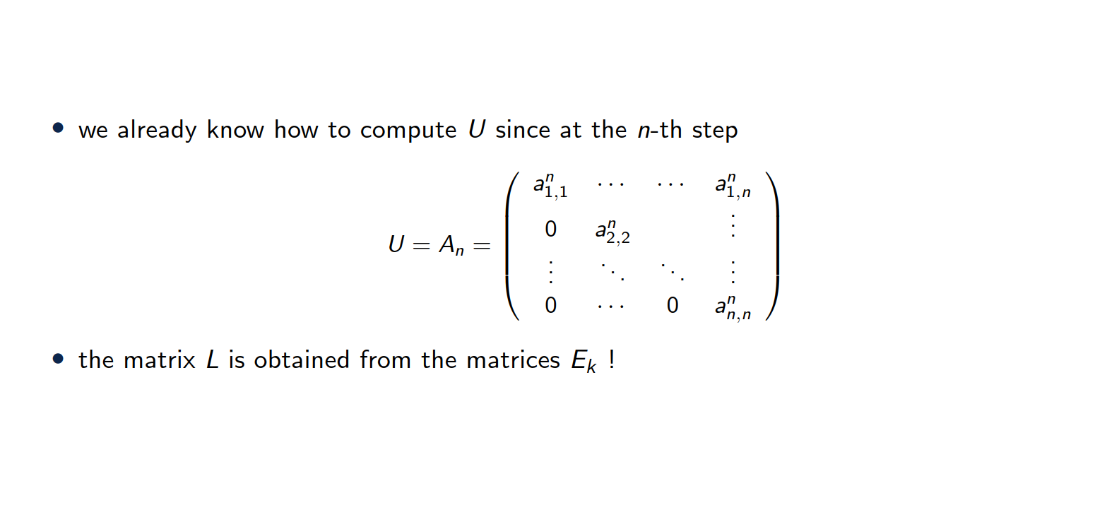
LU factorization

Slide 33
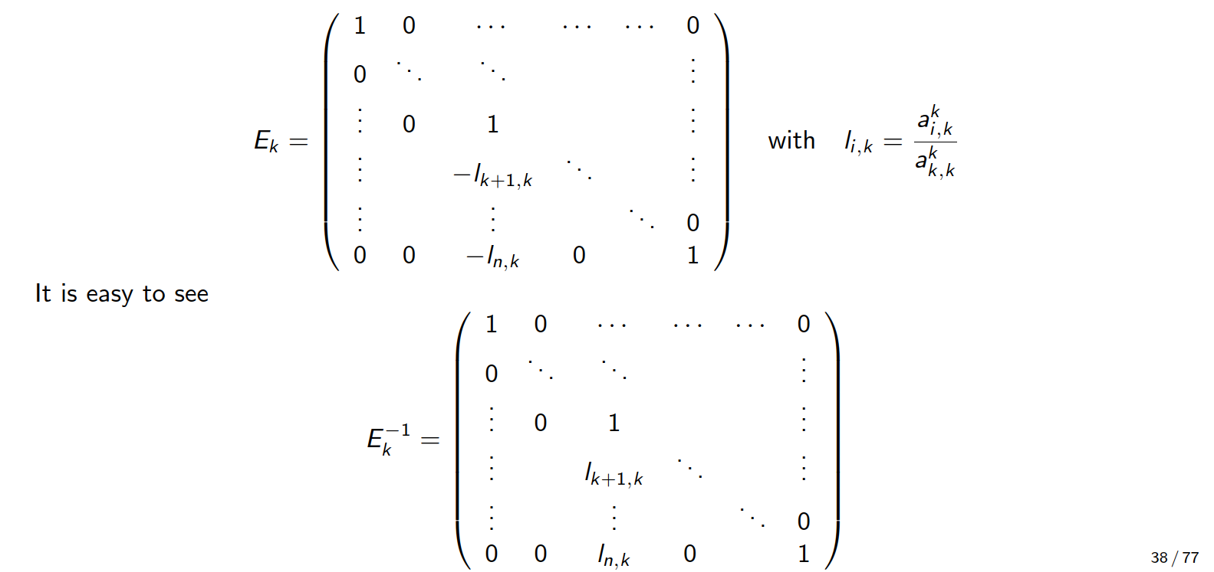
LU factorization

Slide 34
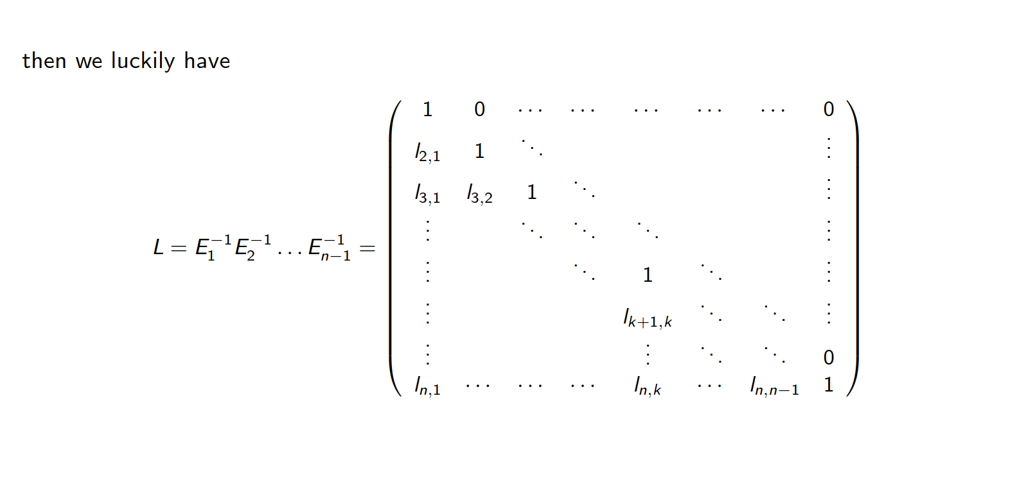
LU factorization

Slide 35
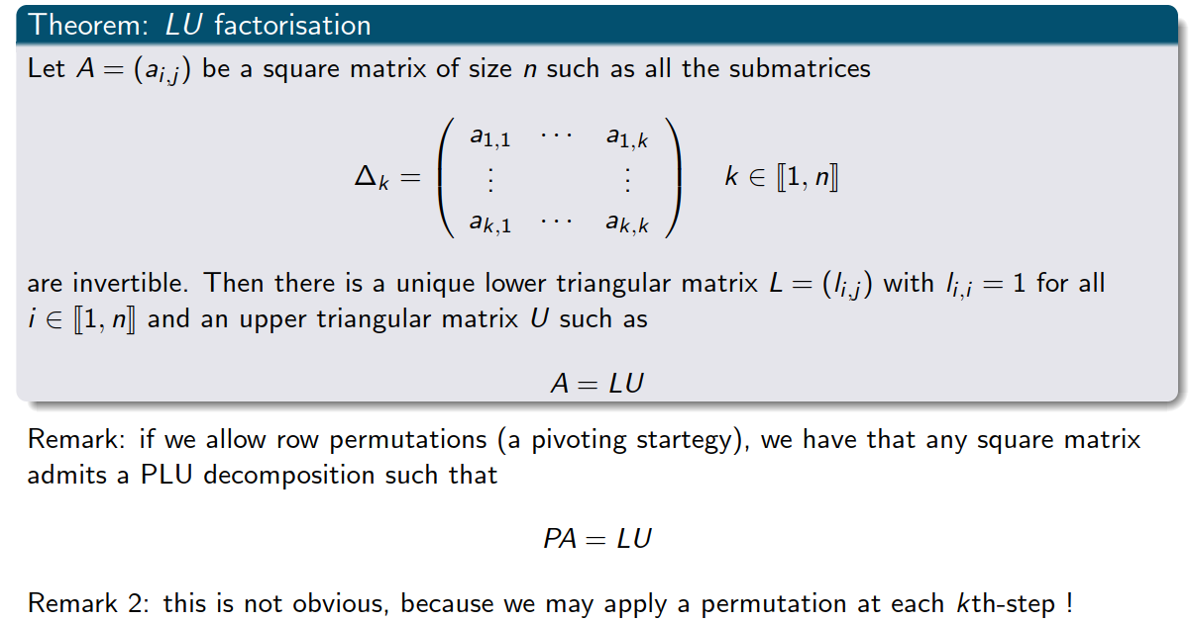
Theorem

Slide 36
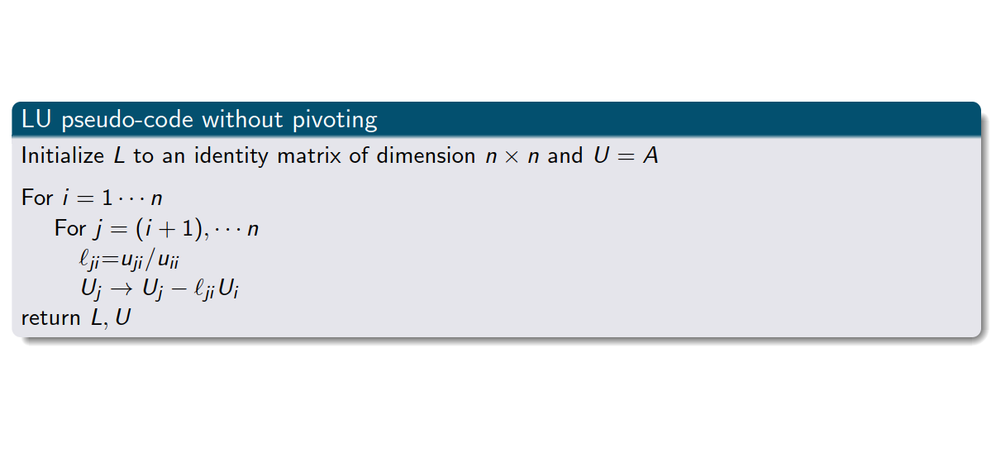
LU factorization pseudo-code

Slide 37
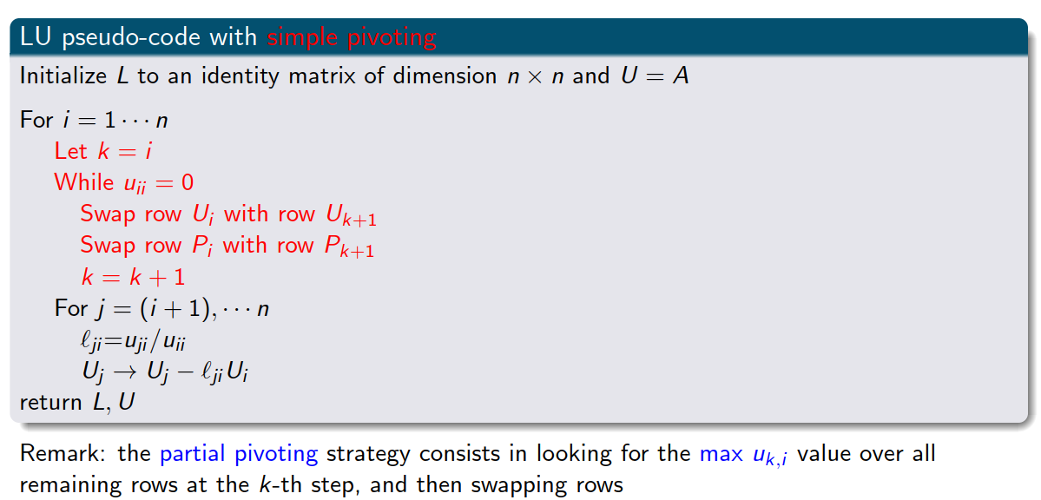
LU factorization pseudo-code with pivoting

Slide 38
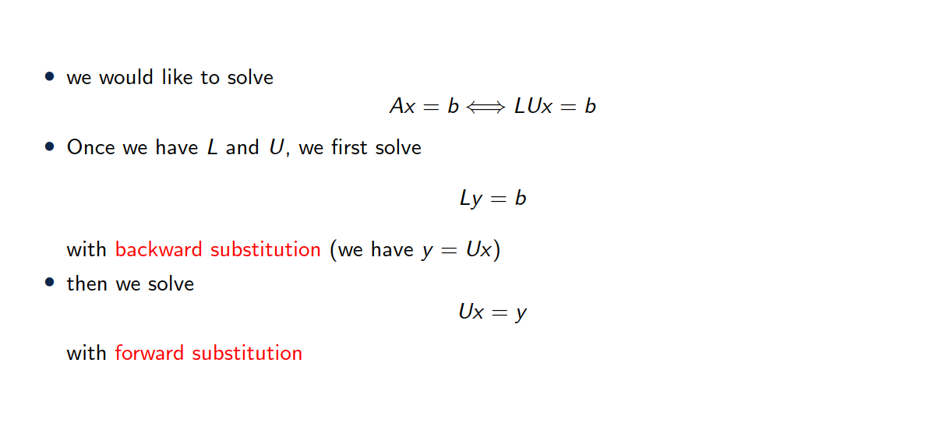
Solving a linear system with LU factorization

Slide 39
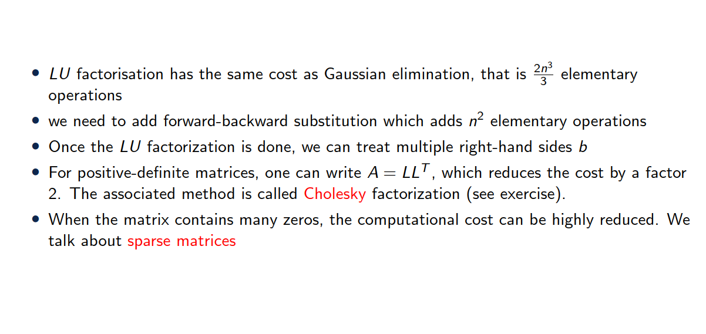
Factorization cost

Slide 40
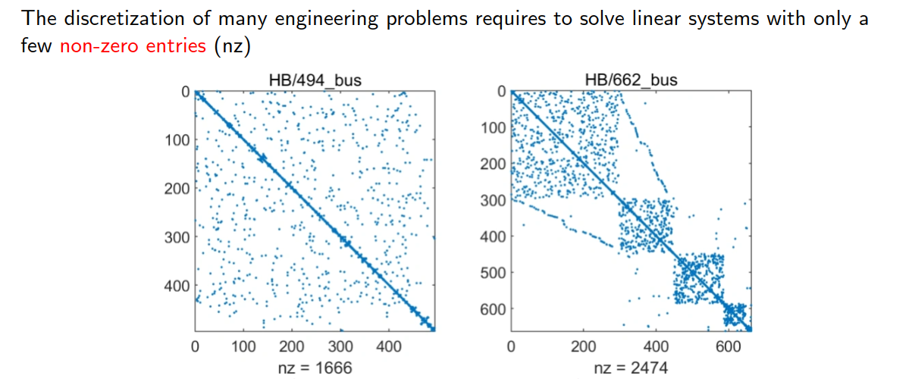
A few words on sparse matrices

Slide 41
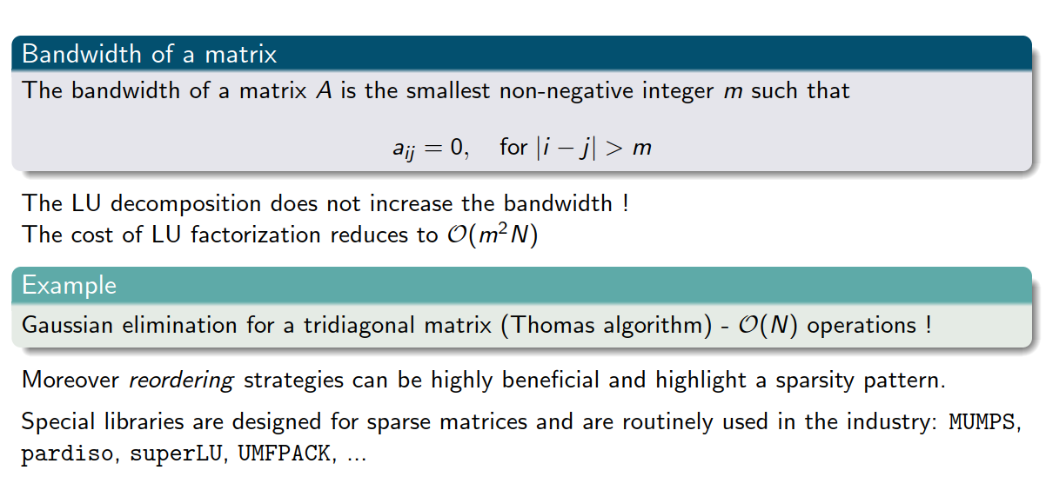
A few words on sparse matrices

Slide 42
3. Iterative solvers

Slide 43
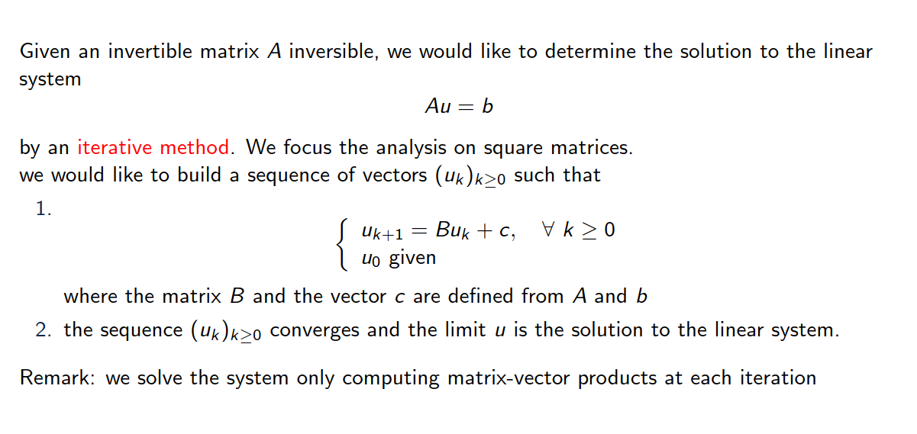
Introduction

Slide 44
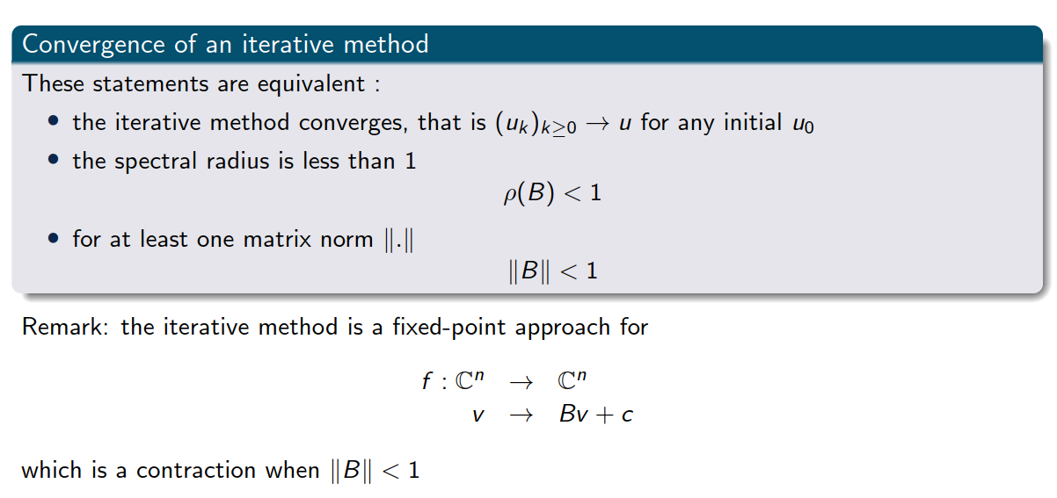
Some basic notions

Slide 45
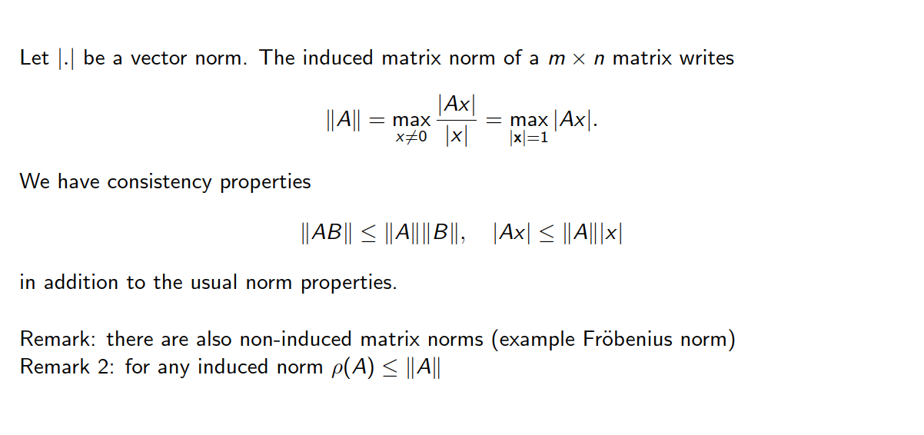
A few notes on matrix norms and spectral radius

Slide 46
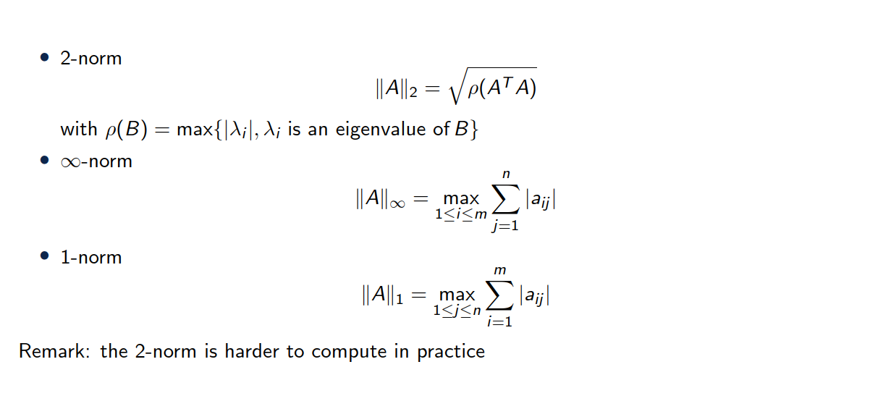
Some induced matrix norms

Slide 47
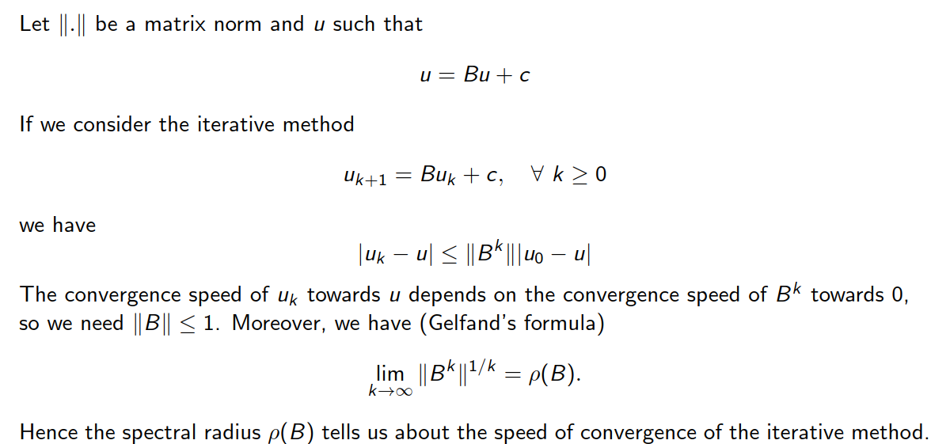
Speed of convergence

Slide 48
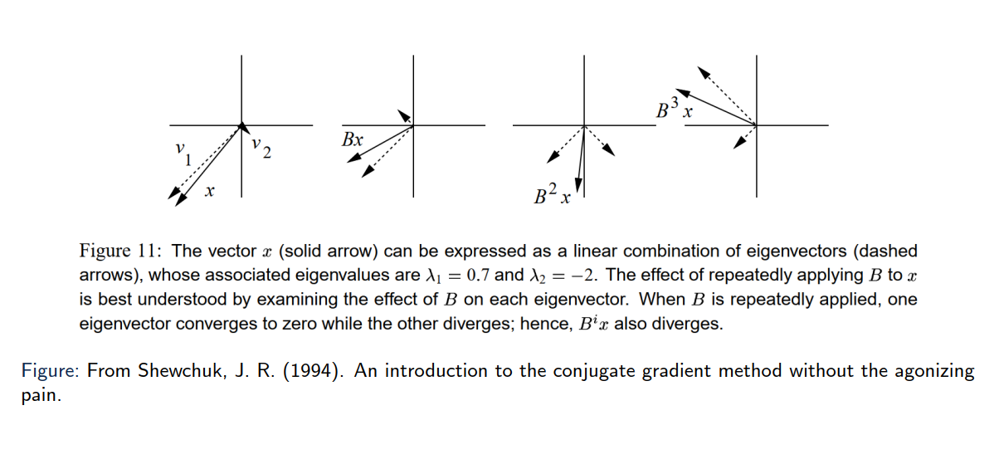
Some basic notions
Eigen vectors only get scaled, not changed in direction!

Slide 49
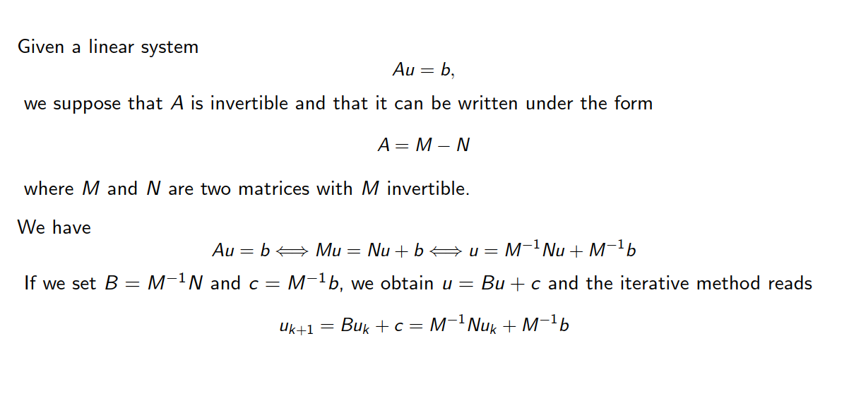
Another matrix decomposition

Slide 50
Some basic notions

Slide 51
Some basic notions

Slide 52
Some basic notions

Slide 53
Some basic notions

Slide 54
Some basic notions

Slide 55
6. Summary

Slide 56
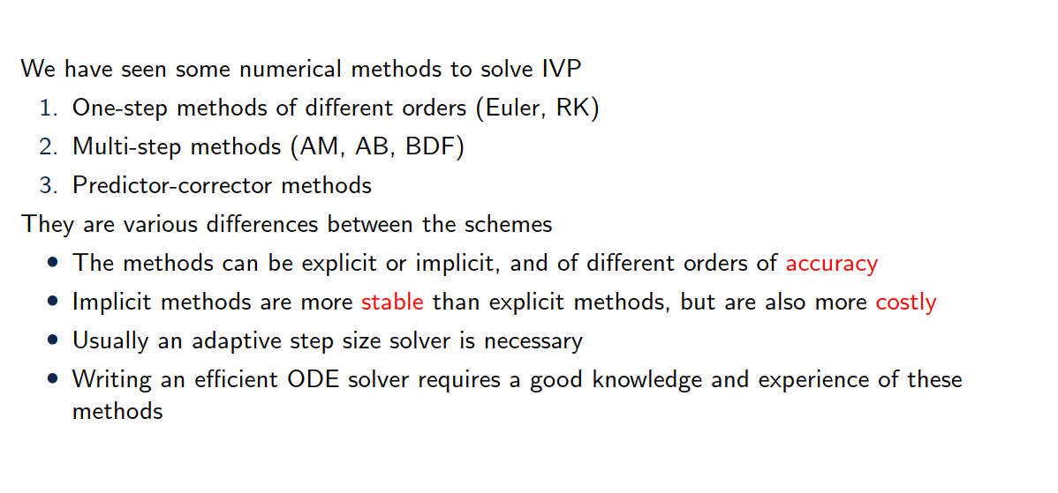
Summary

